Slide 1
Supervised machine learning project –
Reasons for US citizens’ hesitance to get the COVID-19 shot?
Julia Nießl
03.06.2022

Slide 2
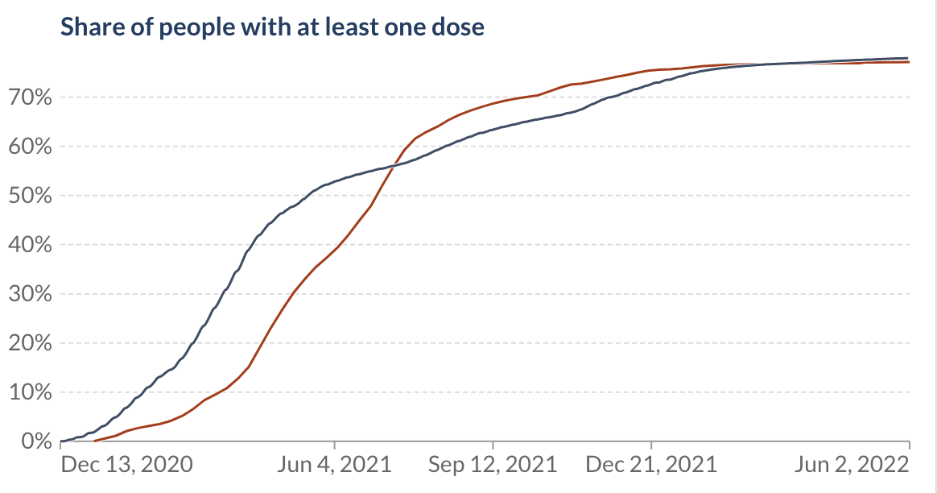

COVID-19 vaccine - USA
April 2021: Vaccine eligibility for all residents over 16
Estimation: 90% coverage necessary for herd immunity
Ourworldindata.org
Determinants of population’s hesitancy to get vaccinated?

Slide 3
University of Cincinnati using online survey by Qualtrics Feb/Mar 2022
n= 3553
Target
Vaccine hesitant: Refusing or not planning to get COVID-19 vaccine (0=No, 1=Yes)
Features (41)
Trust & Knowledge about vaccines/science (0-10)
Vaccine Trust Index
Natural Science Literacy
Trust Science Community
Trust Science Apolitical
Trust Science Politicians
Trust Science Media
Trust Media
Political affiliations/
beliefs
Party ID
Biden
Trump
Trust National
Trust State
Trust Local
PS Index
Evangelical
COVID-related factors
Perceived Risk
Perceived Network Risk
Age
Preexisting conditions
Infected Personal
Infected Network
County cases
County Cases 2wk
Pandemic Impact
Pandemic Impact Network
Vaccine required
Demographics
County density
Race
Male
College Degree
Household Income
Comfort in healthcare
Doctor Comfort
Fear Needles

Slide 4
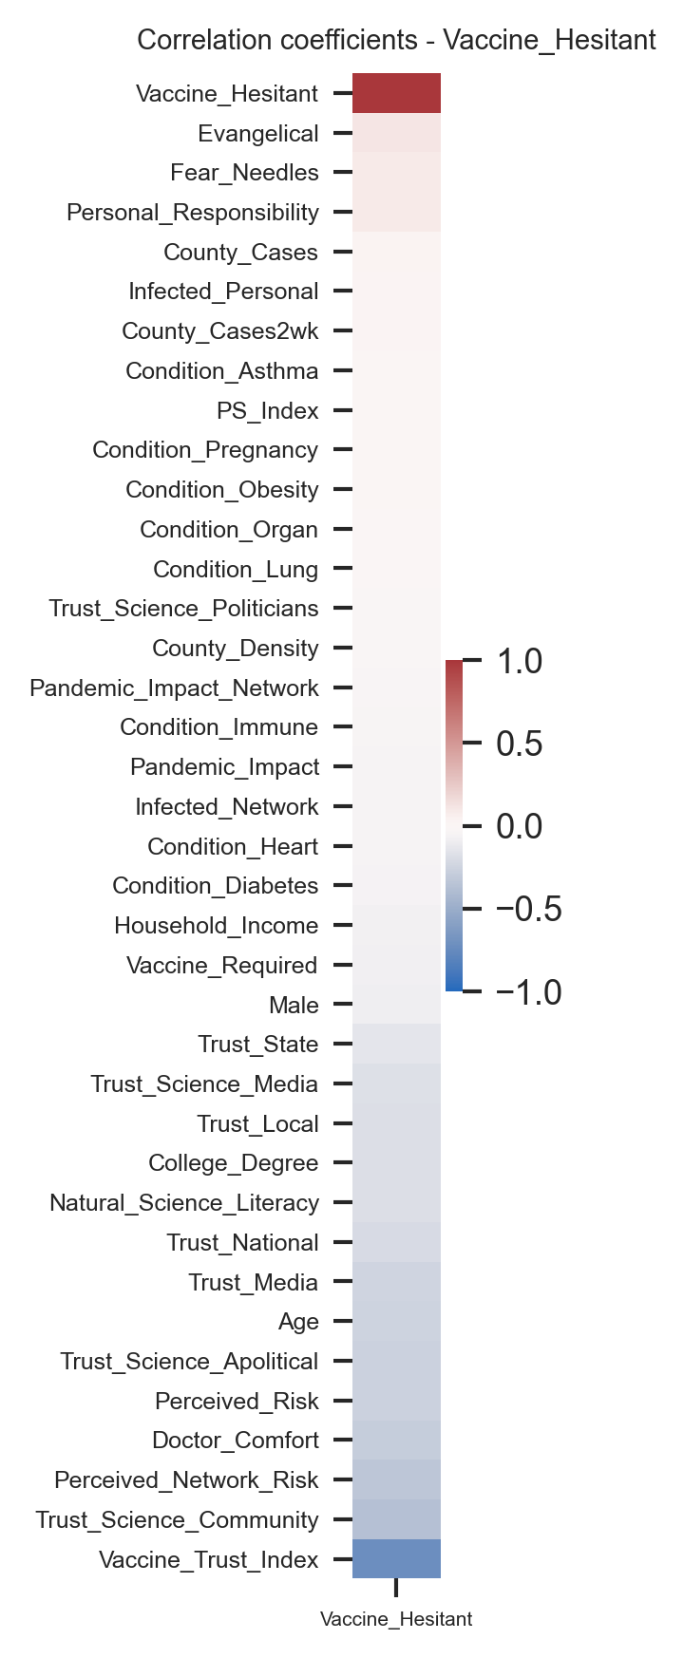
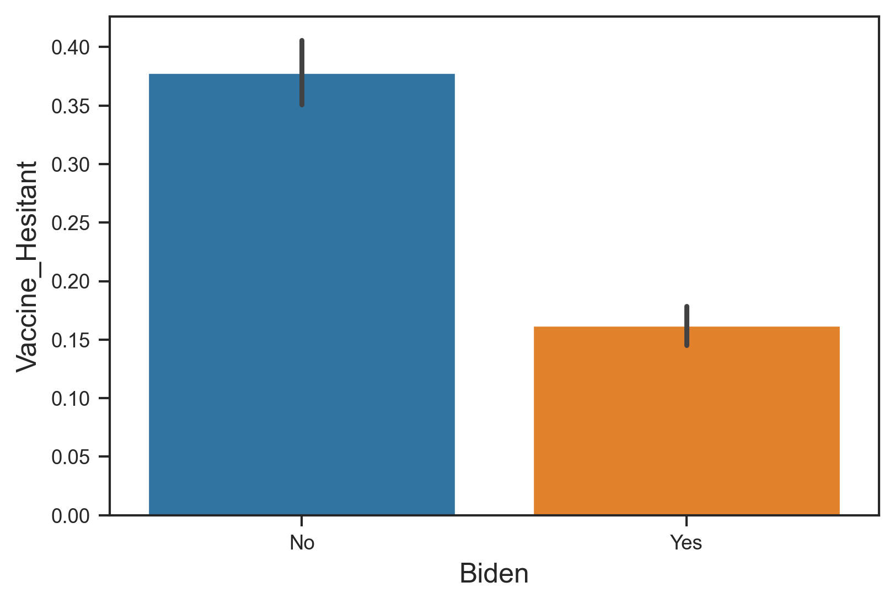
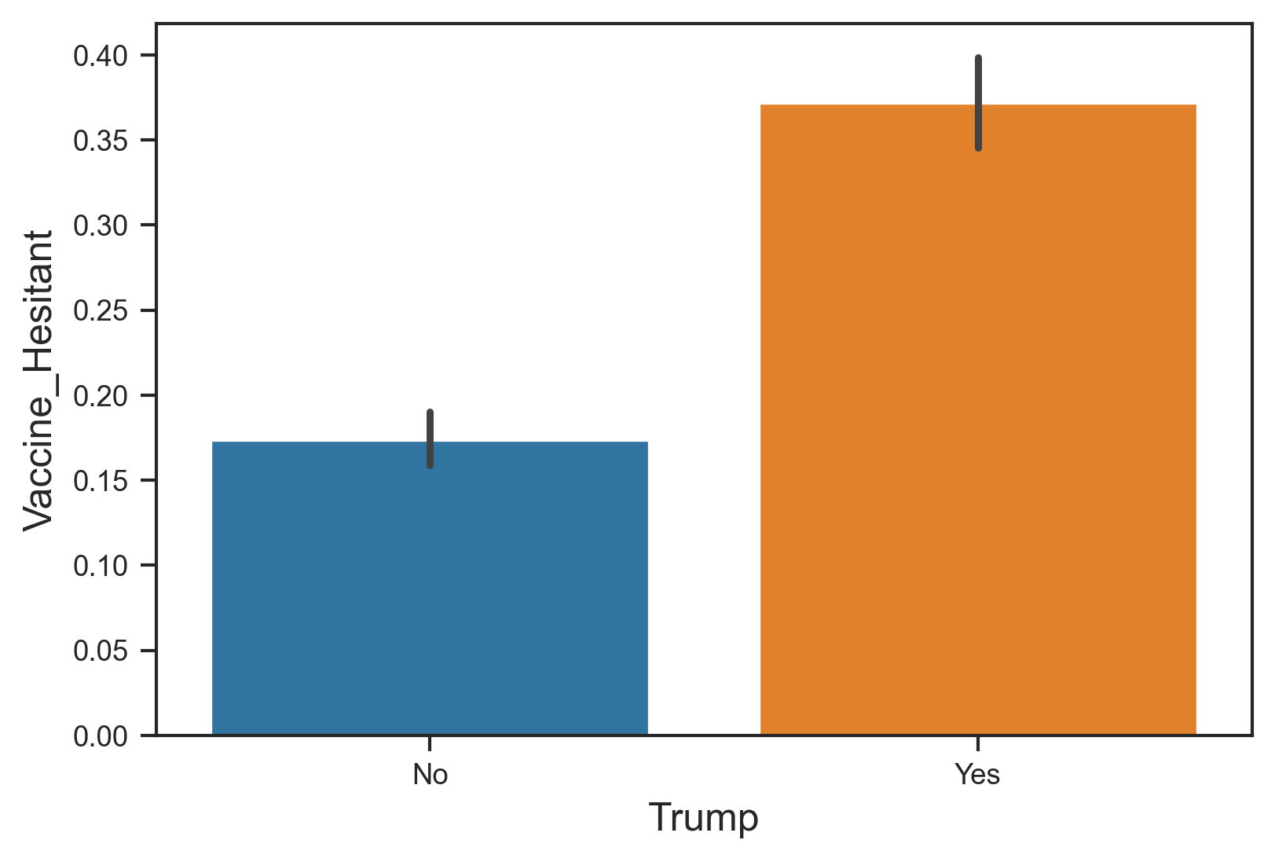
EDA - Examples
Considerations for model
Which features explain vaccine hesitancy? → Included all
Baseline accuracy=0.75
Scoring method: Accuracy

Slide 5
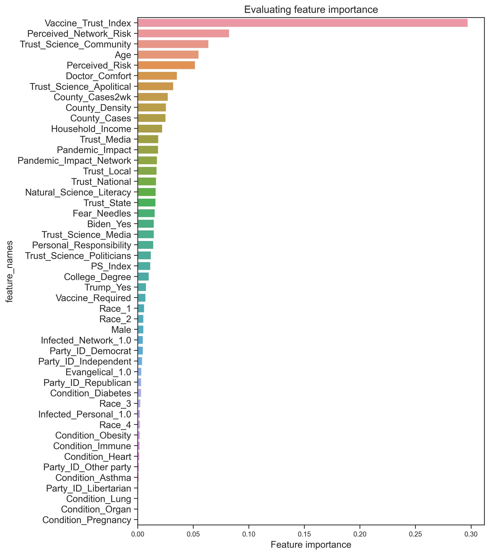
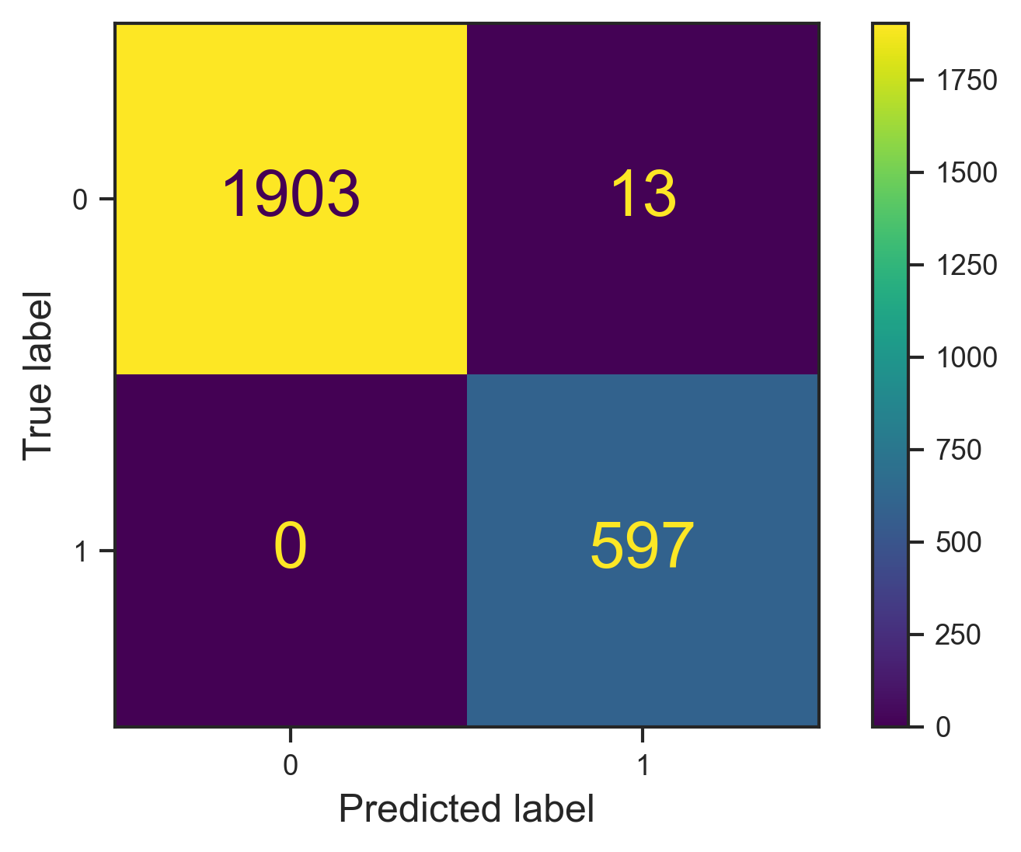
Best model: RandomForestClassifier
All 41 features included
Train data set

Slide 6
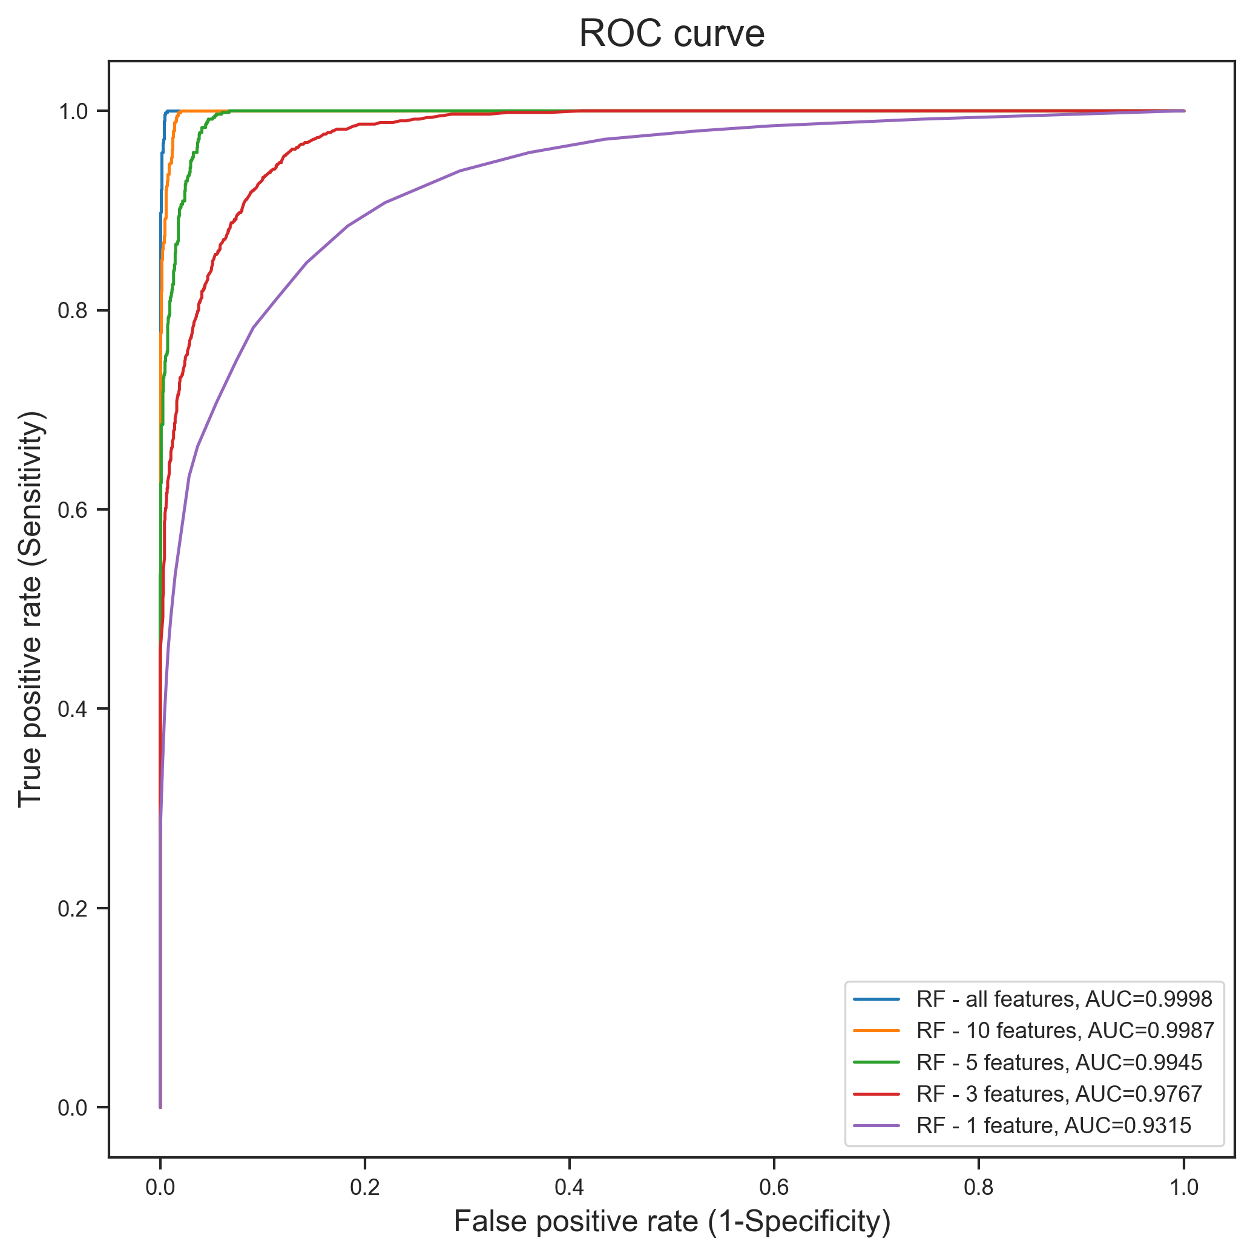
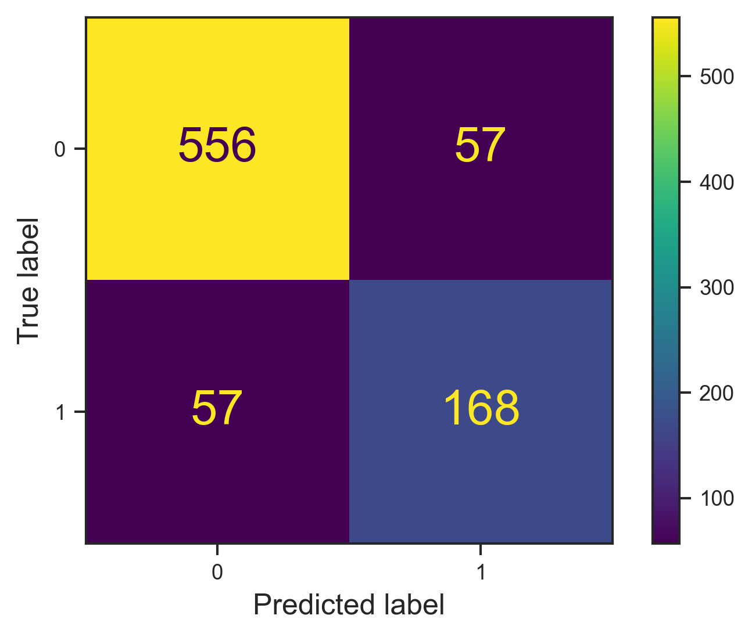
Best feature evaluation – simplifying the model
Evaluation of RF – 5 features on test dataset
Accuracy =0.864

Slide 7
Conclusions
5 features predict vaccine hesitancy with very high accuracy
Features already showed good correlation prior, but model allows to evaluate strength of each
→ Implication: Design of public health campaigns

